Slide 1

SAT and ACT Analysis
2017-2018
A Group 5 Presentation
Anastasiya Ivanova | Bryan Ho | Ng Qi Wen | Peggy Man | Randy Neo
Notes:
Randy - College Board

Slide 2

Agenda
Problem Statement
Objective
Key Findings
Participation Rates
Overview of participation rates SAT vs ACT
Breakdown of states
Conclusions & Recommendations
Selected state
Overall Recommendations
Q & A
Notes:
randy

Slide 3
Problem Statement
1
Participation varies across states.
How can we increase the SAT penetration?
Notes:
We representing the college board..would like to increase the participation rates for SAT.
The ACT and SAT test are standardized tests used for college admissions in the United States.

Slide 4
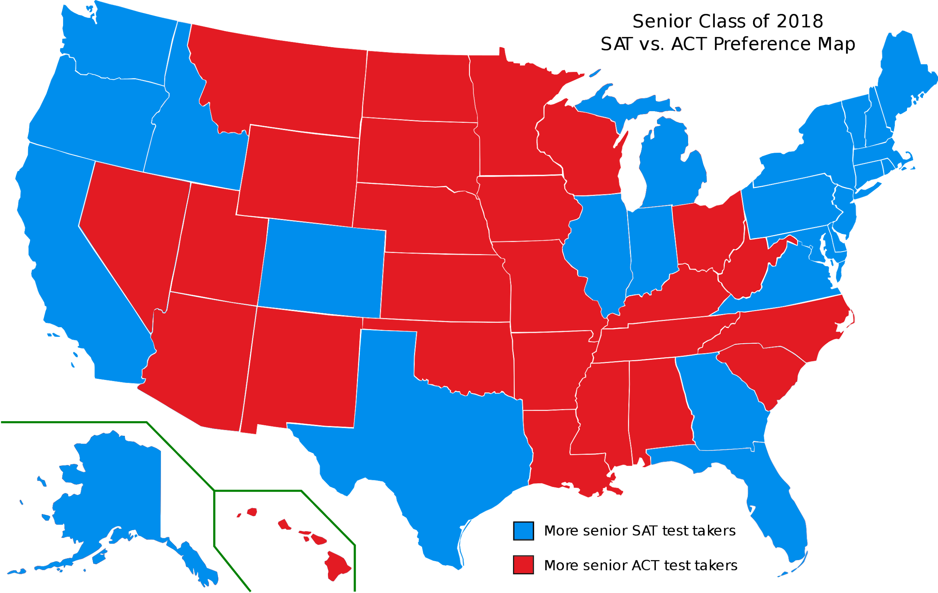
18 States
10 States
22 States
Contracted with ACT
Contracted with SAT
Contract-less
Sources:
https://www.testive.com/state-sat-act/
https://blog.prepscholar.com/which-states-require-the-sat
https://blog.prepscholar.com/which-states-require-the-act-full-list-and-advice
Notes:
- The ACT and SAT test are standardized tests used for college admissions in the United States.
Sun Tze:
“If you know the enemy and know yourself, you need not fear the result of a hundred battles.
Depending on the policy in each state, students are required to take either ACT or SAT
Though colleges does not mandate which exams for student, state policy can be an influence here
As such, while we aim to tackle those states with high penetration in ACT but low penetration in SAT. further lobbying by the management is necessary to penetrate further.
Thus we look into states that are contractless
There is still more work to be done.

Slide 5
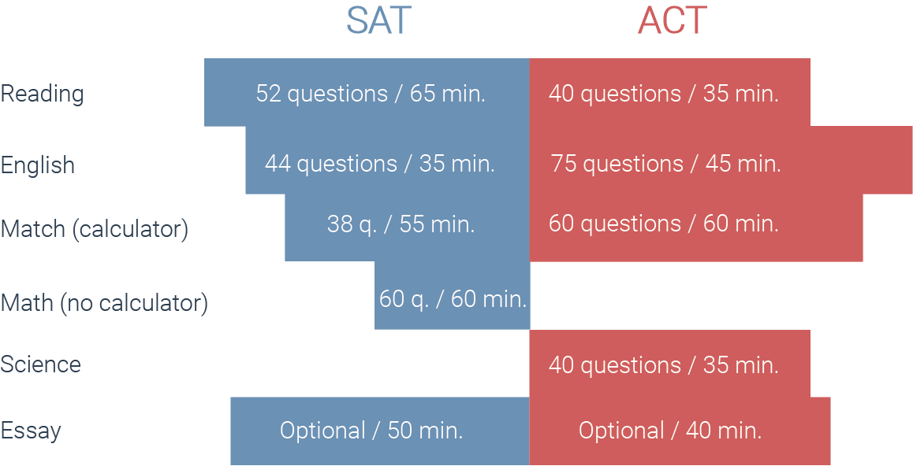
Dataset
We have worked with Datasets, categorised by each State.
Dataset obtained :
SAT 2017 & 2018
ACT 2017 & 2018
Dataset contains :
Participation Rates
Individual Module Scores
Total / Composite Scores
Notes:
- For our analysis, we relied on Data extracted from https://blog.collegevine.com/here-are-the-average-sat-scores-by-state/
- The ACT is divided into four multiple choice subject tests: English, Maths, Reading and Science with scores ranging from 1-36 for each subject.
- 2 section scores result from taking the SAT: Evident-based Reading and Writing and Math. Section scores are reported on a range of 200-800.

Slide 6

Objectives:
Track statewide participation
Recommend where money is best spent to increase SAT participation rates.
Notes:
Pass on to Qiwen

Slide 7
Key Findings
2
Trend analysis of Participation Rates in 2017 and 2018
Notes:
Here i will present the key findings of our analysis on ACT and SAT participation rates across 2017 and 2018.

Slide 8
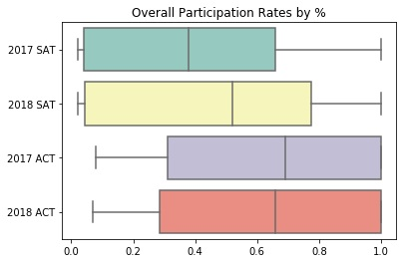
General Overview: Participation Rates
SAT
Concentrated on lower range
Average: ~30-50%
ACT
Concentrated on higher range
Average: ~60-70%
Notes:
Looking at the green and yellow box plot: SAT participation is concentrated on the lower range, with an average of 30-50%. Left end ((indicating 2nd quartile) are nearer to 0%.
Looking at the purple and red plot: ACT participation is concentrated on the higher range, with an average of 60-70%. Right end (indicating 3rd quartile) are nearer to 100%.
Two points to make here are:
ACT participation, on a whole is higher than SAT participation.
However, SAT shows an average increase where ACT shows a slight decrease in its average.

Slide 9
Changes in SAT Participation Rates 2017/2018
Notes:
In this map, we visualize the changes in sat participation rates across 2017/2018.
lighter blue shows lower participation, darker blue shows higher participation
We can see that the states becoming obviously darker in 2018 are Colorado, Illinois, indicating higher sat participation there.
If you focus on the far right and left of the map, states are also turning slight darker in 2018, indicating an overall rise in SAT participation around the coastal areas.

Slide 10
Changes in ACT Participation Rates 2017/2018
Notes:
Here, we visualize changes in ACT participation rates.
It is obvious that we see darker blue or higher participation in the centre / inland areas.
Again, two very obvious changes are colorado and illinois, turning lighter with less ACT participation in 2018. Around the sides of the map, colors are also turning lighter, showing less ACT participation in this areas. These coincide with our previous map
I will now pass on to Bryan

Slide 11
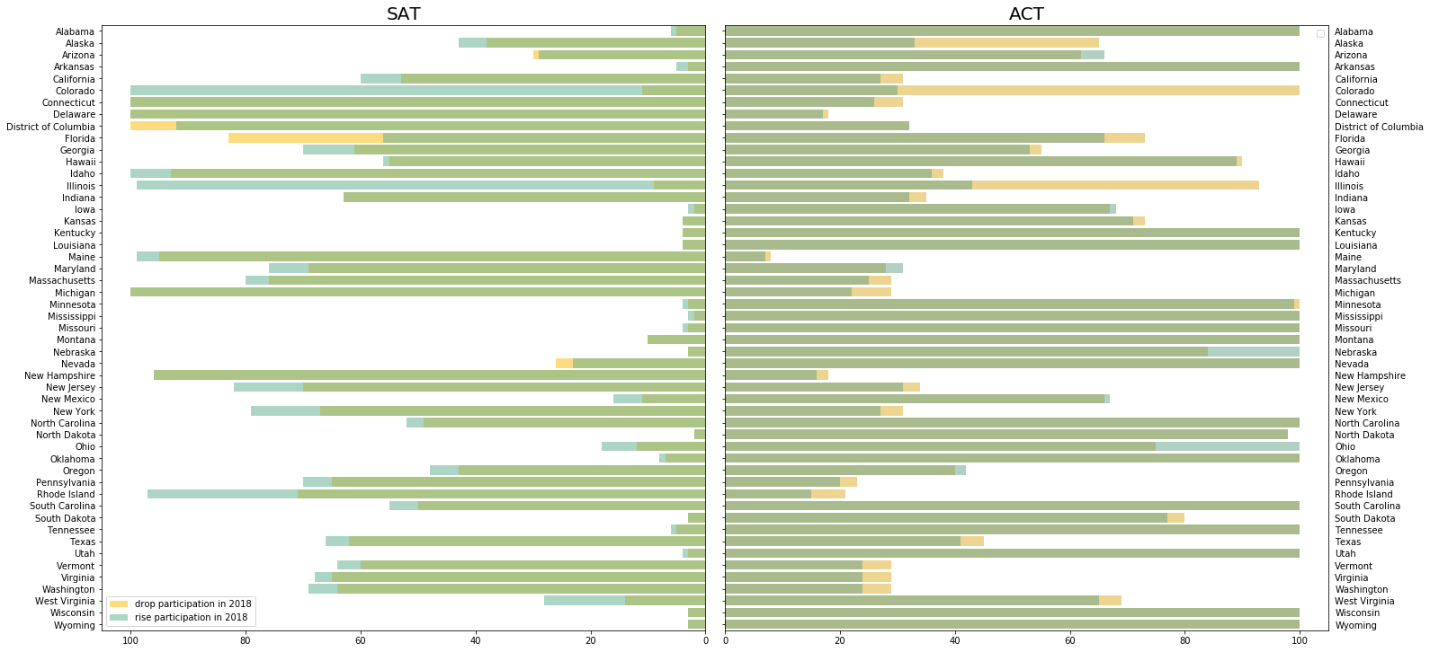
SAT vs ACT: Drop & Rise in Participation 2017/2018
Notes:
Dont be overwhelmed, what we want you to focus on are the blue and orange bits.
Generally SAT has much more states with blues / rises.
ACT has much more states with orange / drops. Opposite trends

Slide 12
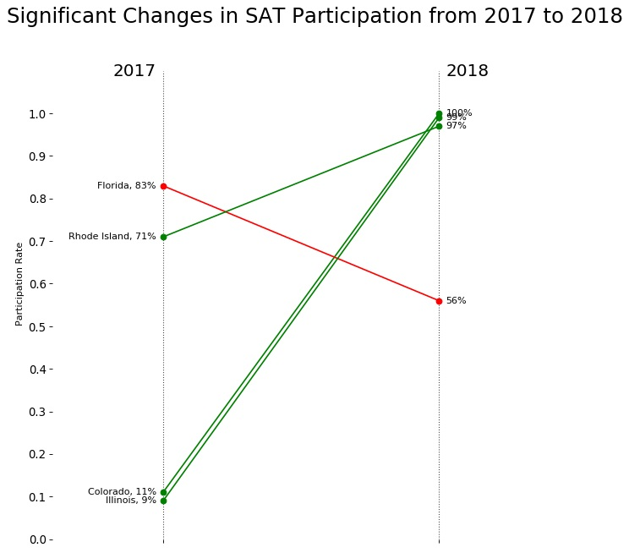
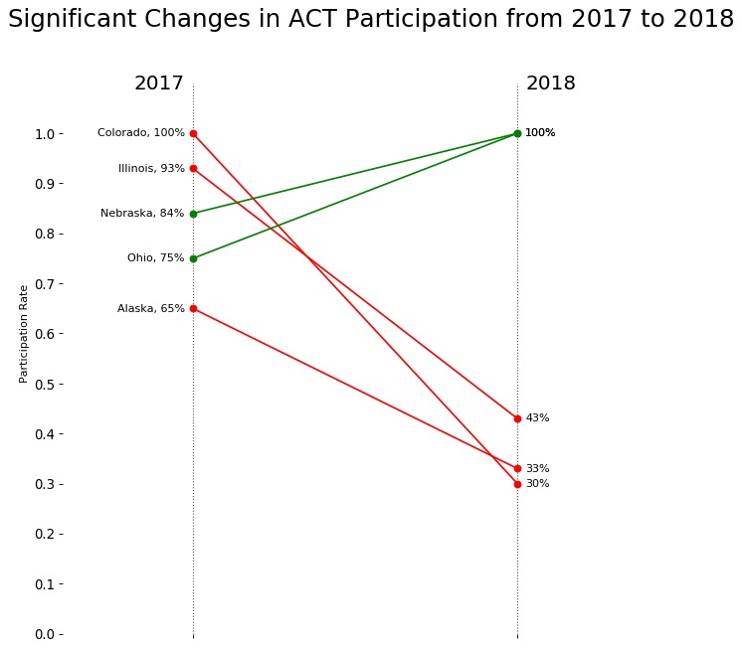
SAT
ACT
SAT vs ACT: States with Significant Changes in Participation Rates
Notes:
Zoom in.
SAT
- Florida had a drop
- Rhode Island, Colorado, Illinois shot up to close to 100%
ACT
Coincides with SAT - Colorado, Illinois dropped
Additional drops - Alaska
Ohio, Nebraska increase to 100%

Slide 13
Conclusions and Recommendations
3
States requiring attention and action
Notes:
Participation in SAT varies across states, with

Slide 14
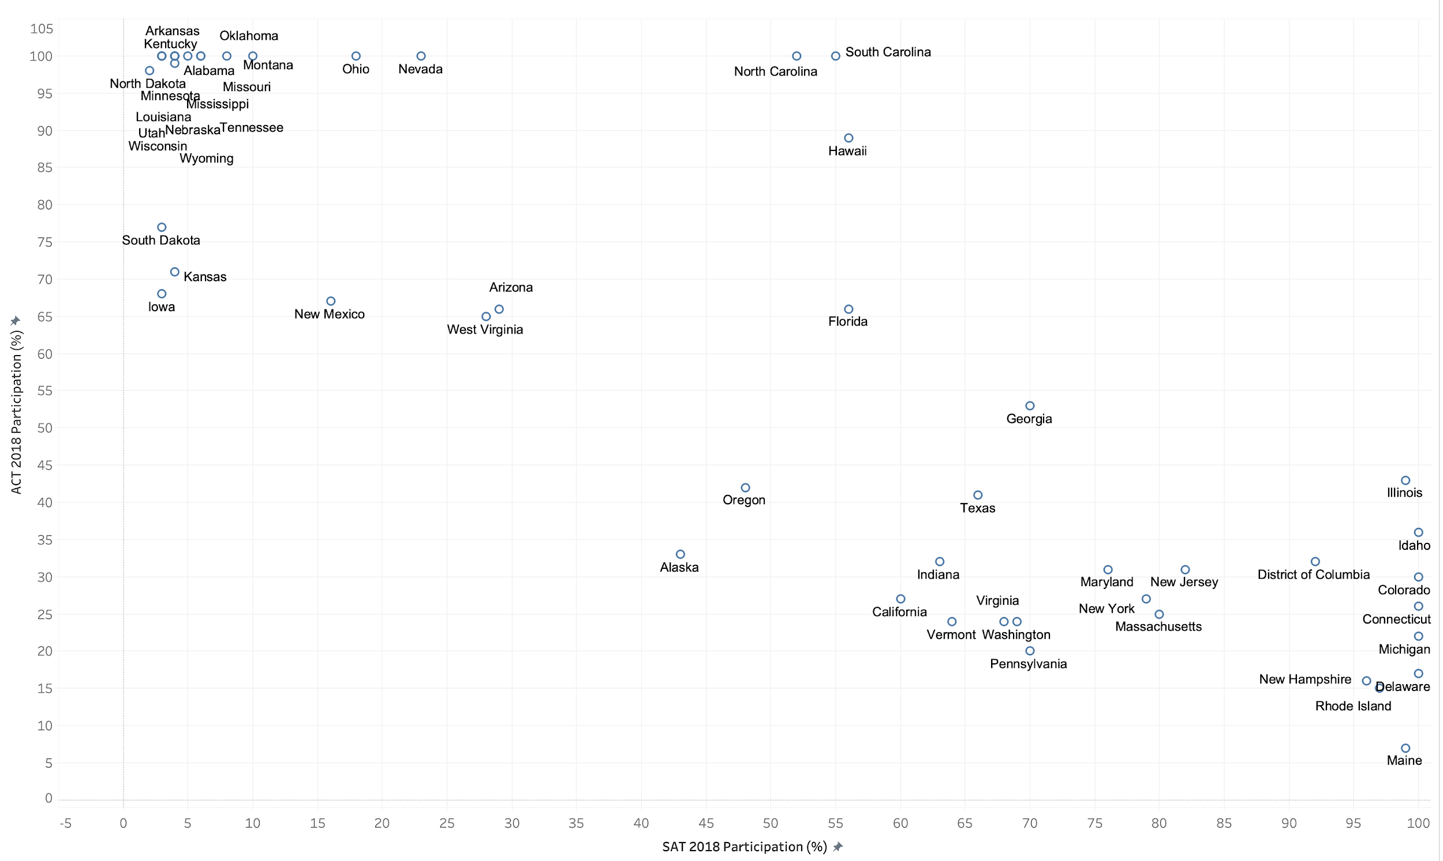
2018 SAT vs ACT Participation Rates by States

Slide 15
Lowest Collective Participation Rates in 2018
State | SAT | ACT | High School Graduates†
Vermont | 64% | 24% | 7K
Virginia | 68% | 24% | 90K
Washington | 69% | 24% | 70K
California | 60% | 27% | 435K
Indiana | 63% | 32% | 73K
† Data Extracted from 2018 SAT Annual Report: https://research.collegeboard.org/programs/sat/data/archived/2018-sat-suite-annual-report

Slide 16
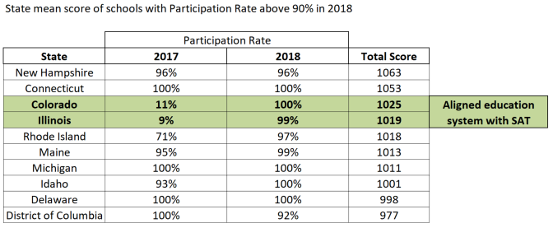
Advantages of SAT
Students show higher resulting scores in comparison with ACT.
SAT School Day and Khan Academy.
Collaboration with the states' department of education (like Illinois and Colorado).
Notes:
“SAT School Day” includes a free SAT exam offered during the school day to make student participation as convenient as possible

Slide 17
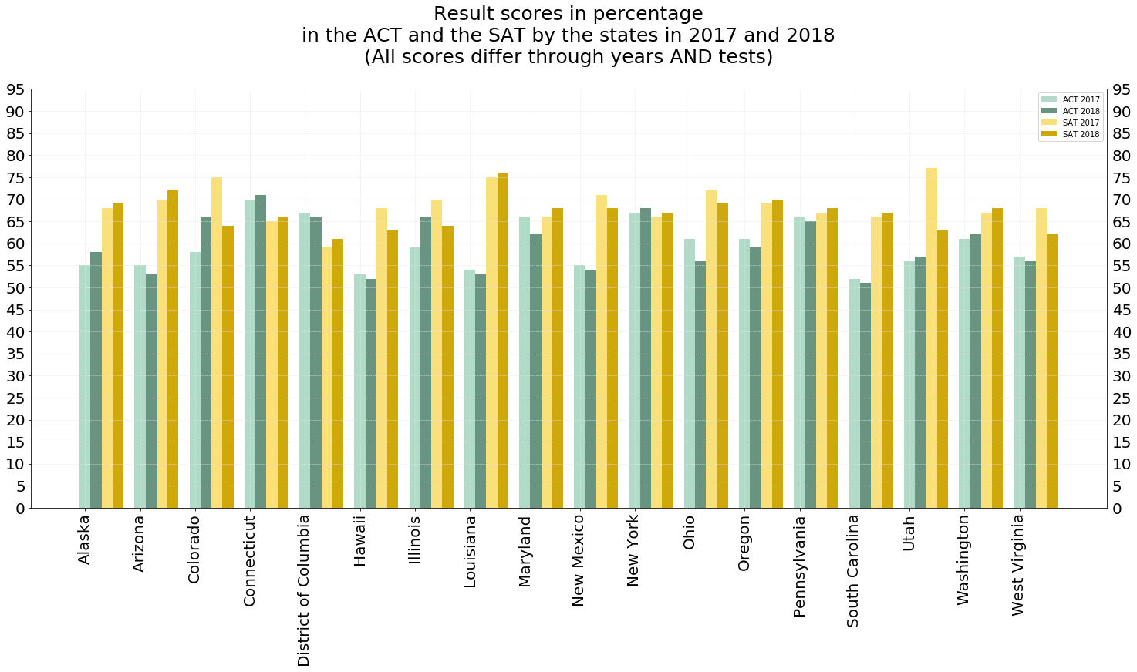
Notes:
Average sat score is all higher than average act scores
In percentage (from maximum score) scale

Slide 18
Overall Recommendations
4
Suggestions and further research
Notes:
Participation in SAT varies across states, with

Slide 19

Overall Suggestions:
Collaborate with the contract-less states' department of education. The ultimate goal is to convince the state government accepting SAT as mandatory test in all schools and sponsorship of exam or study fee.
Broaden the participant base. We can target on working adults in the community who are interested in taking the test and do not have the support of traditional schooling. Our online resources will be handy.
Active Social Media Marketing on the Internet, promotion of articles on the benefits of SAT compared to ACT.
Establishing new scholarships for students who can creatively share their positive experience of passing the test on social networks.
Notes:
Collaborate with the contract-less states' department of education. The ultimate goal is to convince the state government accepting SAT as mandatory test in all schools and sponsorship of exam or study fee.
Broaden the participant base. We can target on working adults in the community who are interested in taking the test and do not have the support of traditional schooling. Our online resources will be handy.
Active Social Media Marketing on the Internet, promotion of articles on the benefits of SAT compared to ACT.
Establishing new scholarships for students who can creatively share their positive experience of - passing the test on social networks.

Slide 20

Recommendations for further research:
Explore Arizona, District of Columbia, Florida and Nevada which have decrease in the participation rate.
Analyse the choice of the students where they can take both tests.
Analyze the performance of the test by students who passed both tests.
Notes:
Explore the states of Arizona, District of Columbia, Florida and Nevada in more detail in connection with a decrease in the participation rate.
Analyse the choice of the students in those states where they can take both tests. Collect data on the desired universities for admission, school performance, demographic characteristics.
Analyze the performance of the test by students who passed both tests. To study the features of assessment, the complexity of the test and subtests.

Slide 21
Thank You
4
Panel open for Q&A
Notes:
Participation in SAT varies across states, with

